Slide 1
Housing 101: Low-Income Housing and its Relationship to Educational Outcomes
Fiona Caretto ○ DATA 205 ○ May 12, 2021

Slide 2
Datasets: dataMontgomery
Moderately Priced Dwelling Units (MPDUs)
Provides data on the number of MPDUs available out of the total constructed units across various “Planning Areas.”
Variables of interest: Planning Area, Total Units, Total MPDUs.
Housing Licensing and Registration
Provides data on housing built in Montgomery County.
Variables of interest: Ownership Type, Property Zip Code, Unit Count.
Note: One of the responsibilities of the Housing Opportunities Community of Montgomery County is to acquire Moderately Priced Dwelling Units (MPDUs) for rental to lower-income families.

Slide 3
Datasets: Maryland State Department of Education
Students Receiving Special Services
Adjusted Cohort Graduation Rate
Provides data on special services for all public schools in Maryland.
I looked at the data for 2015-2019 for Montgomery County and Prince George’s County public high schools.
Variables of interest: FARMS percentage, county, academic year.
Provides data on the graduation rates for all public high schools in Maryland.
I looked at the data for 2015-2019 for Montgomery County and Prince George’s County public high schools.
Variables of interest: graduation rate, county, academic year.
Note: 4-year adjusted cohort rate..

Slide 4
Datasets: Department of Housing and Urban Development
Low-Income Housing Tax Credit
Provides data on low-income housing units and projects around the country.
I looked at the data for Montgomery County and Prince George’s County, specifically pulling the zip codes of the high schools within those counties.
Variables of interest: FIPS2010, Project Zip Code, Total Low-Income (LI) Units.

Slide 5
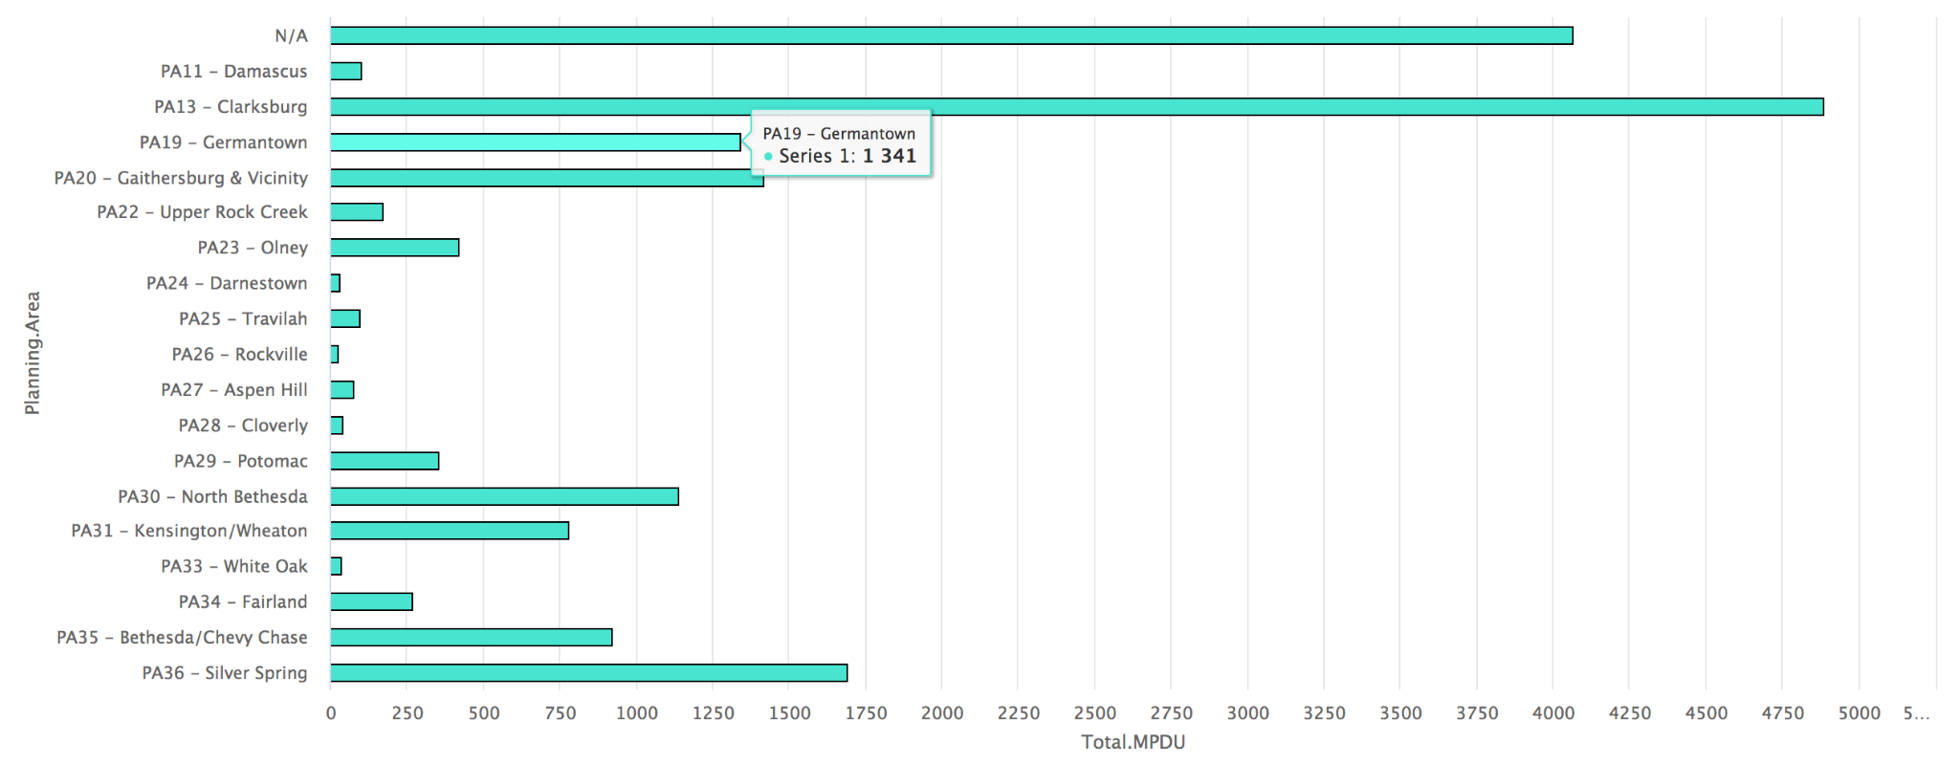
Low-Income Housing Across Montgomery and Prince George’s Counties
Trends: Montgomery Village, Kensington, North Bethesda, Bethesda, Chevy Chase, Silver Spring, Clarksburg among the areas with the most MPDUs/housing units owned by the Housing Opportunities Community.
Notes:
Why do we care?
Affordable housing does not seem evenly distributed across the county.
Research tells us that “economically integrated housing promotes academic success.”
The government could use this data to help plan where to construct affordable housing units to improve the economic integration of housing.

Slide 6
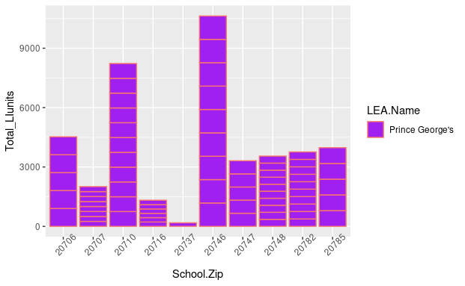
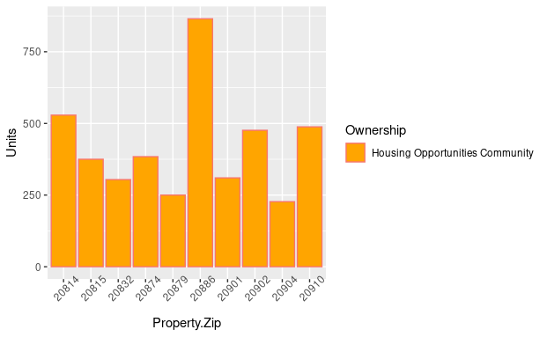
Low-Income Housing Across Montgomery and Prince George’s Counties
Why do we care?
County
Notes:
Why do we care?
Affordable housing does not seem evenly distributed across the county.
Research tells us that “economically integrated housing promotes academic success.”
The government could use this data to help plan where to construct affordable housing units to improve the economic integration of housing.

Slide 7
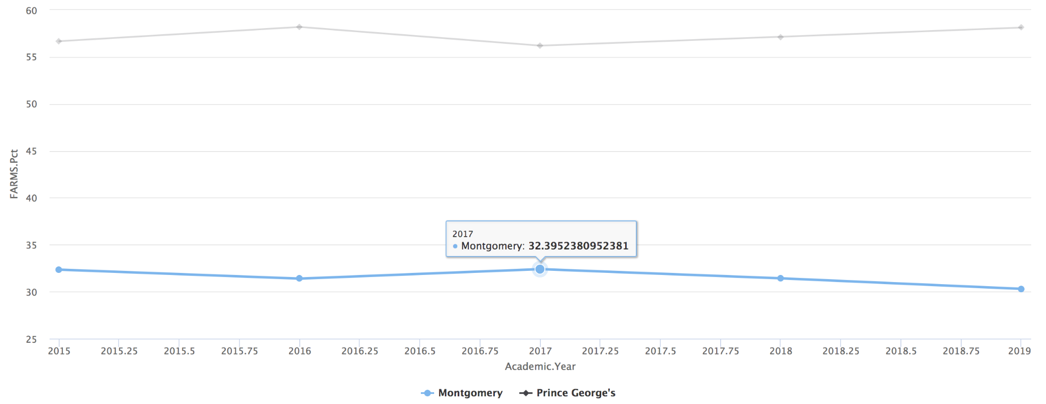
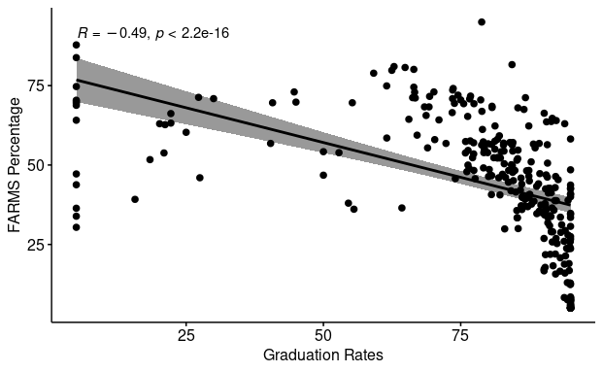
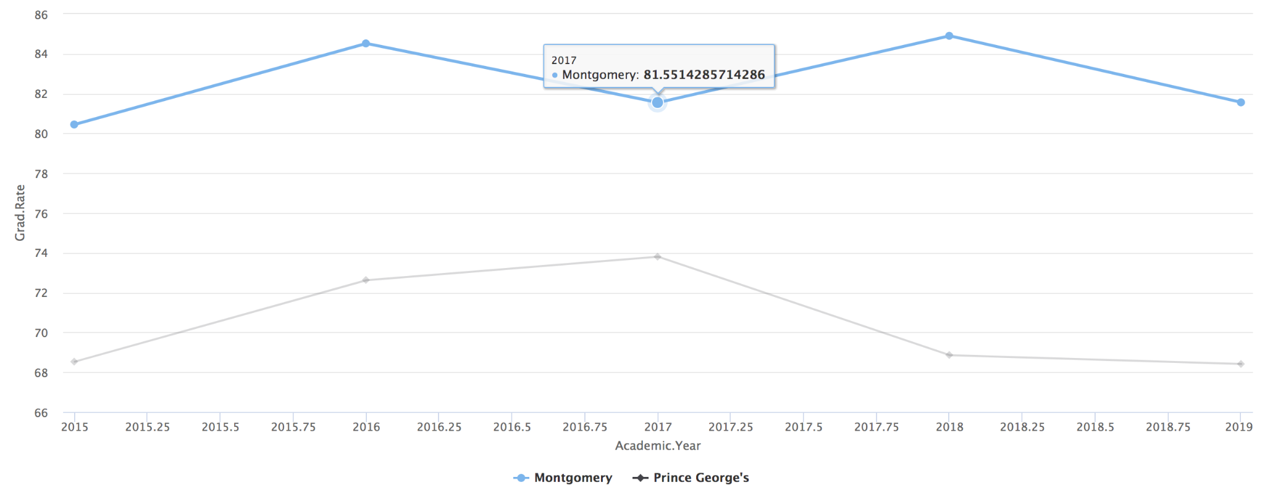
FARMS and Graduation Rates
Pearson’s Correlation Test:
p-value < 0.05
Correlation coefficient of -0.49
Moderate, negative correlation
Why do we care?
Notes:
Is this surprising?
Schools run off property taxes, more kids on FARMS=lower property taxes=fewer resources=decreased school performance=lower graduation rates.
Why do we care?
These variables represent the two primary needs kids are seeking to have fulfilled when they go to school: to be fed/kept safe and to be educated.
This data shows that MCPS is struggling to meet both of those needs simultaneously.
This data can be used to pinpoint the schools that need more resources from the government (i.e., Title I funding).

Slide 8
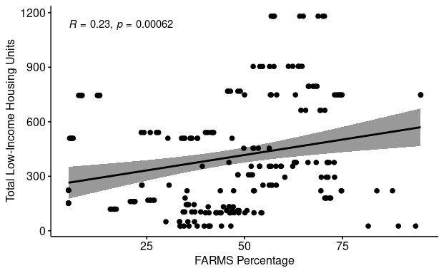
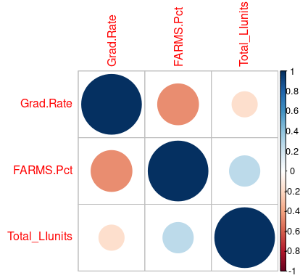
FARMS and Low-Income Housing
Pearson’s Correlation Test:
p-value < 0.05
Correlation coefficient of 0.23
Weak, positive correlation
Why do we care?
Notes:
Is this surprising?
Why do we care?
Research shows that access to affordable housing improves educational outcomes for children from low-income families.
Using FARMS as a measure of financial need, if there is not a strong correlation between students on FARMS and amount of low-income housing, perhaps this is a contributing factor to the lower graduation rates associated with higher percentage of students on FARMS.
The government could use this data to pinpoint where in the county has the most need for MPDUs/low-income housing units.

Slide 9
Future Recommendations
dataMontgomery - Moderately Priced Dwelling Units & Housing Licensing and Registration
A dataset that combines the variables of both of these datasets could be very helpful.
Similar to HUD’s Low-Income Housing Tax Credit dataset, I would recommend a dataset that captures housing projects/units being built in Montgomery County, with the funding source (aka Ownership Type), number of low-income units, project location (more specific than Planning Area like in the MPDU dataset, such as address, city, zip code, like in the Housing Licensing and Registration dataset), etc.

Slide 10
Future Recommendations
dataMontgomery - Ideas for New Dataset
According to Montgomery County’s Department of Housing and Community Affairs website, the Moderately Priced Housing (MPH) Law requires that between 12.5% and 15% of the houses in new subdivisions of 20 or more units be moderately priced dwelling units (MPDUs) and 40% of the MPDUs be offered to the Housing Opportunities Commission (HOC) and other non-profit housing agencies for use by low and moderate income families. Additionally, participants must apply and are selected via a random selection drawing--and the need greatly outweighs the availability of units.
Based on this information, I believe a dataset that leverages the data from the Moderately Priced Dwelling Units & Housing Licensing and Registration datasets to capture quality data on: the amount of MPDUs available (per selection period?), the amount of applicants, the amount of applicants selected, the location of these units, etc., would be of great utility to the Montgomery County government.

Slide 11
Future Recommendations
dataMontgomery - Ideas for New Dataset
Research shows that access to affordable housing increases educational outcomes for children from low-income families, so I believe it would be really useful to collect data on this and provide it through dataMontgomery.
Variables that would be useful to capture: poverty level of families with children who attend MCPS, amount of affordable housing units per school district, a measure of academic success (grades, test scores, graduation rates, etc.).
This could be used to see if academic success improves for children from low-income families when they are provided with affordable housing.
The government could then use this to help plan construction of housing units/affordable housing units and increase the overall success of MCPS.

Slide 12
Acknowledgements
A very big thank you to those who have helped me with my capstone project and throughout the Data Science Certificate Program at Montgomery College. To Professor Saidi, Professor Mohamed, Professor Iapalucci, my classmates, Victoria Lewis, dataMontgomery, and the Montgomery County Government -- I can’t thank you enough for your support and guidance!

